Slide 1
RAG Pipeline- Summarization Shaji Joseph CSCI 685: Computational Lingustics CWID: 50394653

Slide 2
Contents
Process Flow
What is RAG?
RAG Models
Use Case
Program Execution Flow
Limitations and Improvements
References

Slide 3
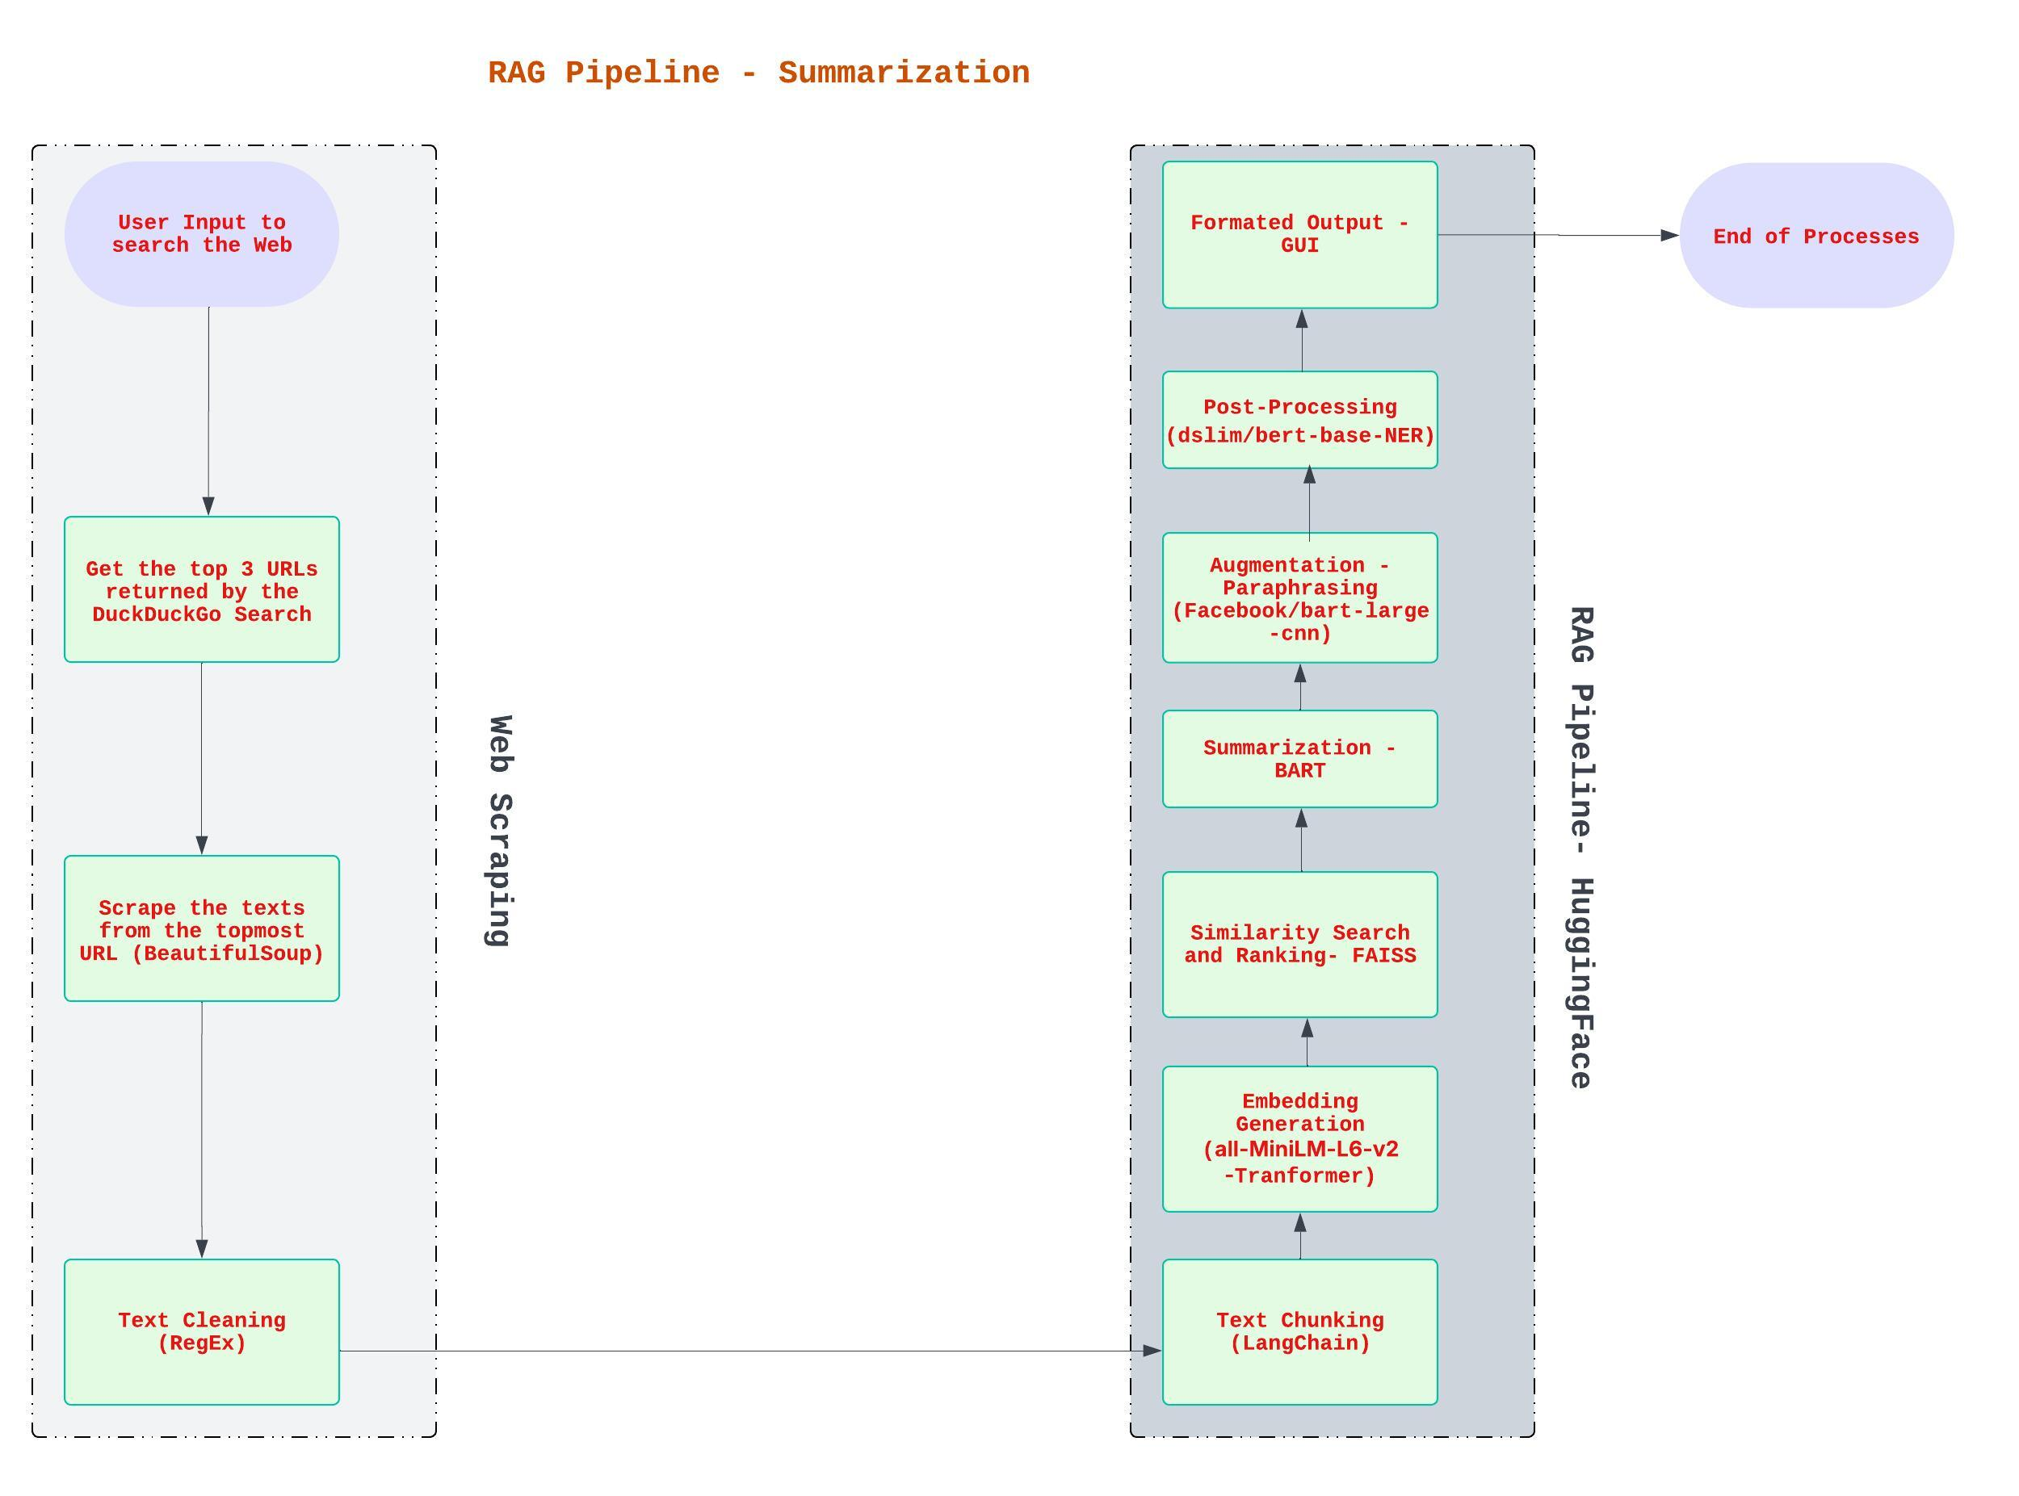
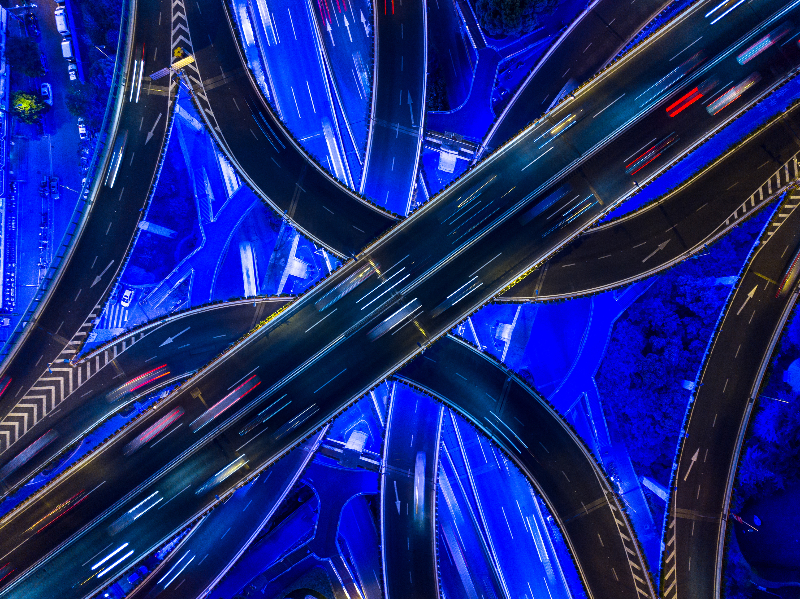
Process Flow
The Process flow above can be summarized as User Input → DuckDuckGo Search →Top URLs → Scraping →Text Clean → Chunking → Embedding → Similarity Search → Summarization → Augmentation → Post Processing→ Display in GUI

Slide 4
What’s RAG
Retrieval-augmented generation is a technique for enhancing the accuracy and reliability of generative AI models with information fetched from specific and relevant data sources (Lewis et al., 2020; NVIDIA, n.d.).
Even the most advanced generative AI models can only generate responses based on the data they have been trained on. They cannot provide accurate answers to questions about information outside their training data. RAG is a framework that addresses this limitation by combining retrieval-based approaches with generative models. It retrieves relevant data from external sources in real time and uses this data to generate more accurate and contextually relevant responses (Lewis et al., 2020).
The Retriever component of a RAG System collects, processes, stores, and retrieves data. In our use case, the user inputs a search string which initiates a web search to gather relevant information from primary sources and then stores the information.
Query results are converted into chunks and embeddings. A vector indexing and query encodings are applied.
Similarity scores are calculated, and Augmentation is performed to enrich the output summary.
Finally, the output(Summary in our case) of the retrieved input is generated and displayed.

Slide 5
RAG Models-Why did I chose this Model?
I had the following options to choose for the RAG Pipeline.
Complex Question Answering RAG Pipeline, RAG Pipeline for Summary, Chatbots, Sentiment Analysis with RAG, and Multimodal Search RAG Pipeline.
Pipeline | Complexity | Best For | Key Challenges | Drawbacks
Complex QA | High | Multi-hop reasoning | Loop management | Time restrictions
Summarization | Medium | Document condensation | Context length limits | Abrupt end of summaries and capitalization
Chatbots | Medium | Dynamic conversations | Latency optimization | Too many solutions out there
Sentiment Analysis | Low-Medium | Domain-specific sentiment | Over-engineering risk | Too many solutions out there
Multimodal Search | High | Cross-modal retrieval | GPU resource needs | Time Restrictions
Complex QA needs models like GPT-4, Claude 3, Llama need high-cost APIs. Cheaper models have limited functionalities. Summarization needs models like BART-large-CNN, and GPT-4-turbo but BART struggles with long texts and GPT-4 is expensive. Chatbots and Sentiment Analysis are overused and have low complexities. Multimodal Search may be using CLIP or GPT-4V. CLIP lacks granularity and GPT-4V is expensive and slow. Weaker models like LLaVA-1.5 require GPU and weaker than GPT-4V.
I chose RAG Pipeline for Summarization is because I could use all-MiniLM-L6-v2, a fast and lightweight model for summarization. Also, the inputs or search strings are domain specific, and outputs are more accurate and scalable.

Slide 6
Use Case of the RAG Pipeline
User Input (GUI):
A user query is entered via a GUI.
Web Search:
Uses DuckDuckGo to fetch top URLs related to the query.
Web Scraping:
Downloads and cleans text content from the first URL.
Text Chunking:
Splits the cleaned text into manageable chunks.
Text Embedding:
Converts both the chunks and user query into dense vector embeddings.
Similarity Ranking:
Measures similarity Scores between query and Text chunks and selects the most relevant content.
Summarization:
Summarize the relevant content.
Paraphrasing:
Paraphrases the summary sentence-by-sentence
Named Entity Capitalization:
Correctly capitalize proper nouns.
Display:
Outputs the final paraphrased and polished summary in the GUI.

Slide 7

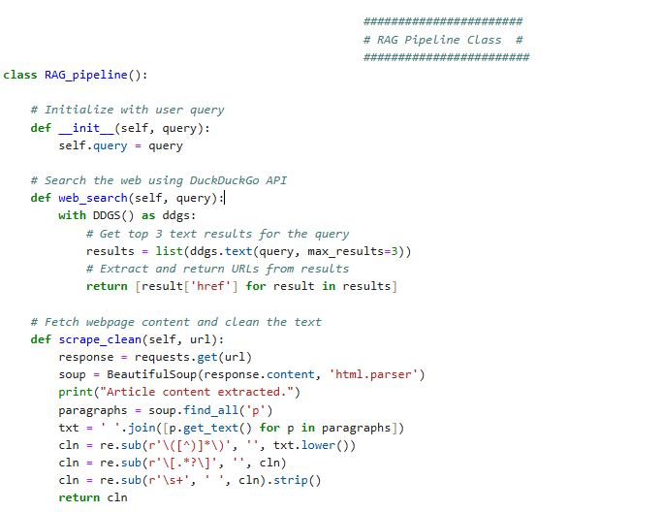
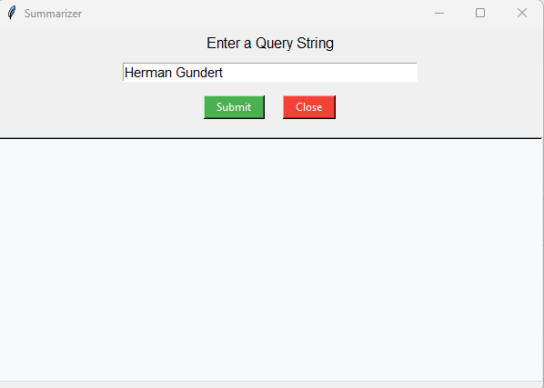
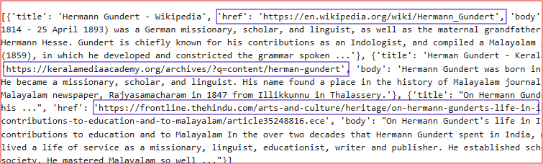
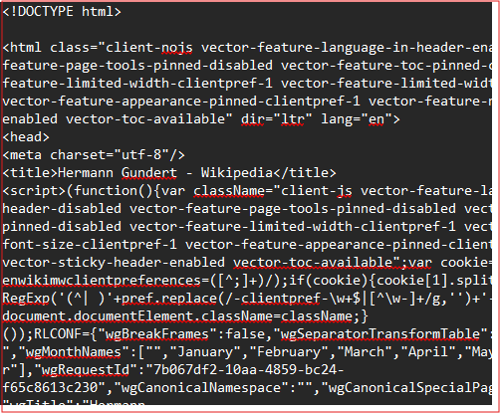
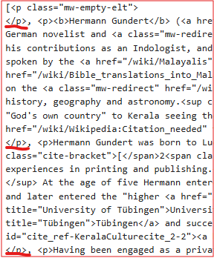
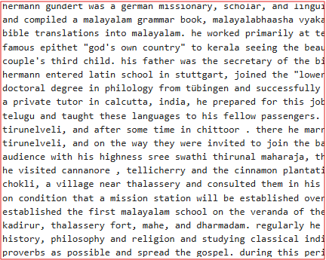
Web Scarping
The program starts with the initialization of a Python Class RAG_pipeline. The Constructor method takes two parameters, self and query.
Query stores the user search string and search.query makes the user input accessible throughout the class.
The web_search method defines a search of the user input using the DuckDuckGo search engine and returns top three URLs to scrape.
The Python method scrape_clean is for getting html content of the URL, parse it, and extract the paragraphs, combine the texts in the paragraphs, and clean the texts by removing parenthesis, remove square brackets and contents, and normalize whitespaces.
BeautifulSoup is used to parse the raw html content, extract the texts from paragraphs, and for removing the HTML tags. Regular Expression is used to clean the texts. Below given are the outputs of the program at each execution steps.
Python Code for Web Scraping
and Cleaning
Top 3 URLs Fetched
GUI for User Query and Response
Cleaned Text
BeautifulSoup HTML Parsing
BeautifulSoup Paragraph Extraction

Slide 8
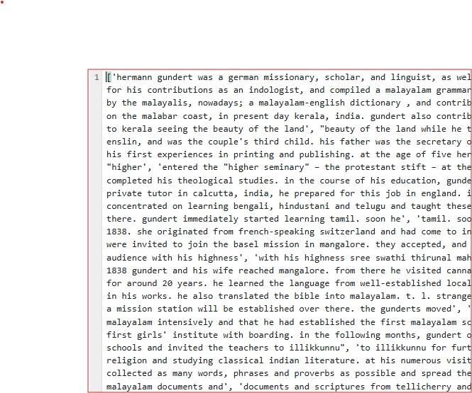
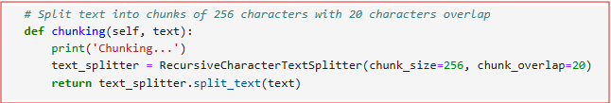
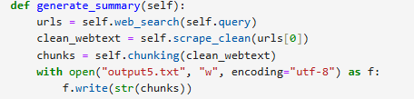
RAG Pipeline-Chunking
Split the input texts from the Web Scarping to Chunks using RecursiveCharacterTextSplitter class from langchain Library. Chunk size is set to 256 characters and chunk overlap is set to 20 characters
Code for Chunking
Chunks

Slide 9
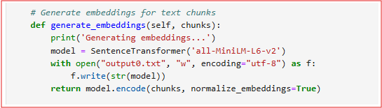
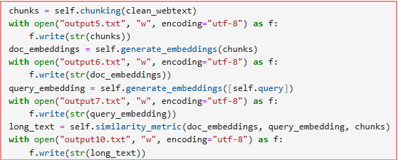
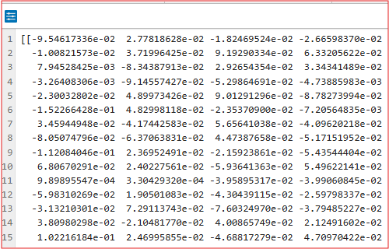
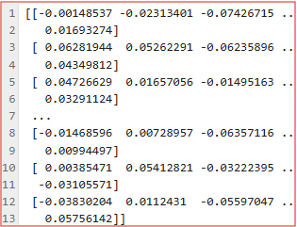
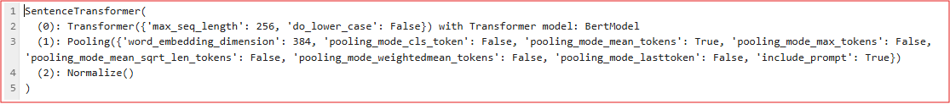
RAG Pipeline - Embeddings
Embeddings generation takes Chunks as input to generate Embeddings. It uses the pre-trained transformer model, all-MiniLM-L6-v2 to generate the embeddings. This transformer model is taken from the SentenceTransformer library.
Code for Embeddings
Sentence Embeddings &
Query Embeddings
Vector of the User Query (Query Embeddings)
Vector of the Web Text
(Sentence Embeddings)
Embeddings(all-MiniLM-L6-v2)

Slide 10
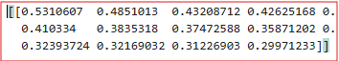
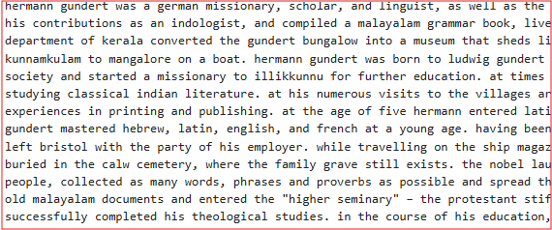
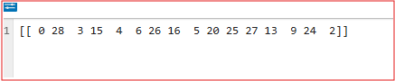
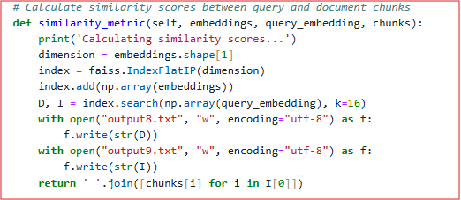
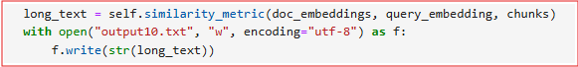
RAG Pipeline – Similarity Score
Similarity Calculation, calculates the similarity scores between Query embeddings and the embeddings generated from the Chunks. It uses FAISS (Facebook AI Similarity Search) for the calculation.
Distances(Similarity Scores) of the top matches
Text generated based on the Similarity Scores for the Web Text
Indices of the top matches in Embeddings
Code for Distance and
Indices
Code for generating texts based on Similarity Scores

Slide 11

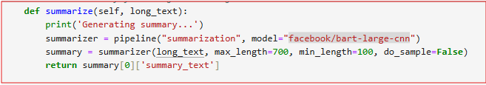
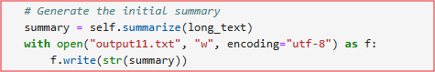
RAG Pipeline – Summarization
Summarization of the web text received from scrapping is uses Hugging Face’s Transformers library to generate it.
The Transformer based model used here is facebook/bart-large-cnn, which is a version of BART (Bidirectional and Auto-Regressive Transformers)
It takes the long texts generated based on the similarity scores as the input to generate the summary.
Code for Summarization
Summary

Slide 12
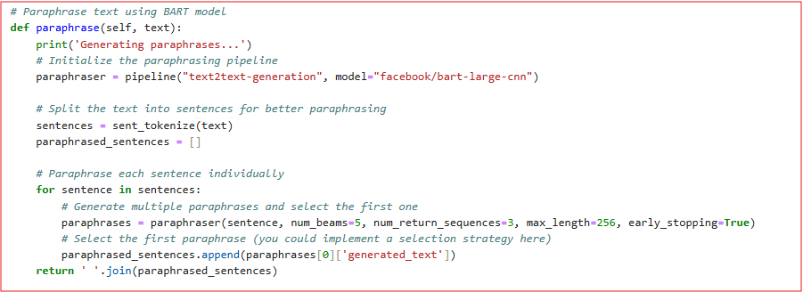
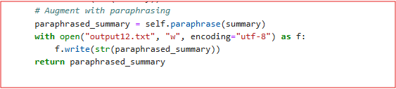
RAG Pipeline – Paraphrasing (Augmentation)
For paraphrasing we use Hugging Face’s pipeline() function and text2text-generation task, and it uses the BART model.
It paraphrases the summary generated earlier for the Web Texts.

Slide 13
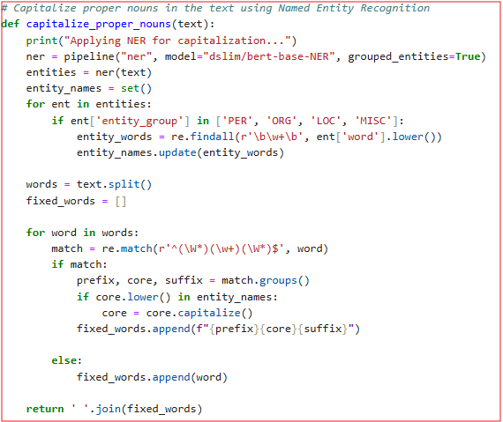
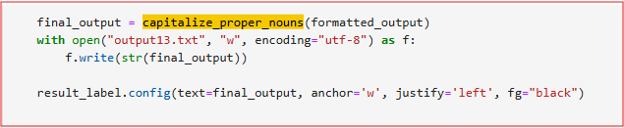
RAG Pipeline – Named Entity Recognition (NER) -Postprocessing
NER capitalizes proper nouns such as people, places, and organizations and it uses Hugging Face NER pipeline.

Slide 14
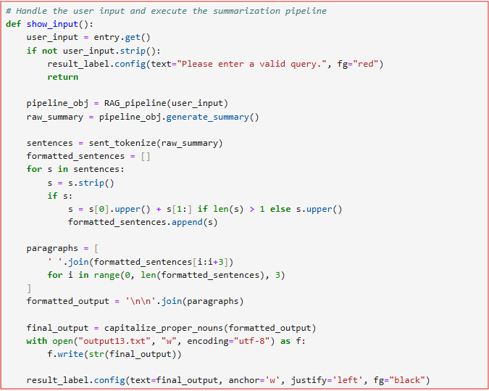
Setting up the GUI
An instance of RAG_pipeline class using the User Input is created. Formatting of the final output using NLTK is done here.
Formatting such as striping whitespaces and grouping sentences to paragraphs are done at stage.

Slide 15
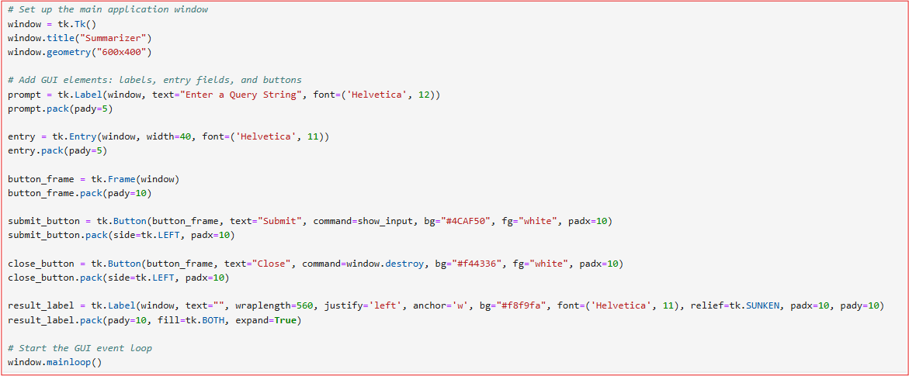
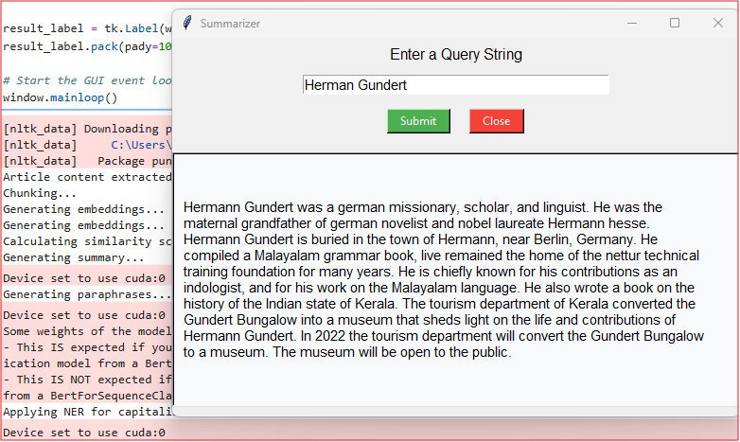
GUI Layout
A GUI is displayed at this stage with buttons and output text area using Tkinter library of Python.
The final output is displayed on this window.

Slide 16
Limitations and Improvements
Limitations: Single Search Engine Dependency - Relies only on DuckDuckGo (no fallback if it fails)
Fixed Chunk Size - Using a static chunk size=256 may split semantically meaningful units.
Similarity Search Granularity - Top 16 chunks are selected based on inner product similarity without filtering or by semantic coherence.
BART Summary Truncation – We manually truncate the tokenized input using max length=1024 and decode it before summarization.
Capitalization based on lowercase matching of NER outputs may fail when entities appear in alternate forms.
No Error Handling - No try/catch blocks around web requests, model loading, or inference. No retries for failed requests or CAPTCHAs
No Evaluation or Logging - Debugging and benchmarking are harder.
Areas of Improvements: Add multiple search providers and Implement retry logic
Dynamic chunking based on semantic boundaries
Language detection and handling
For missed capitalizations or false positives, use NER token offsets and replace directly or consider spaCy's doc.ents.
Add cross-encoder reranker (BERT reranker)
Dynamic length adjustment based on content and context-aware paraphrasing
Comprehensive error handling and limited output - No source citations
CPU/GPU Switching - Smart device management

Slide 17
References
duckduckgo-search. (2025a, April 17). PyPI. https://pypi.org/project/duckduckgo-search/
Beautiful Soup Documentation — Beautiful Soup 4.13.0 documentation. (n.d.). https://www.crummy.com/software/BeautifulSoup/bs4/doc/
Dib, F. (n.d.). regex101: build, test, and debug regex. Regex101. https://regex101.com/
Hugging Face – The AI community building the future. (n.d.). https://huggingface.co/
Jurafsky, D., & Martin, J. H. (2000). Speech and Language processing: An introduction to natural language processing, computational linguistics, and speech recognition. In Prentice Hall eBooks. https://nats-www.informatik.uni-hamburg.de/pub/CDG/JurafskyMartin00Comments/JurafskyMartin00-Review.pdf
Python 3.13 documentation. (n.d.). Python Documentation. https://docs.python.org/
Rothman, D. (2024). Rag-driven generative ai: Build custom retrieval augmented generation pipelines with LLAMAINDEX, Deep Lake, and pinecone. Packt Publishing.

